Slide 1
Machine Learning to Study Patterns in Chess Games
Isaac Cheng

Slide 2
Table of Contents
Introduction
Background
Aims and objectives
Design, methods, and implementation
Downloading the Data, Data Processing
Code demonstration
Classification, regression, clustering
Conclusion
Project outcomes, limitations, future work

Slide 3


Introduction
One of the oldest and most popular board games globally
Rich history – first literature appeared in 840
‘Book of the Chess’
Large-scale exploration has only caught on recently
Stockfish – 9,400 years of CPU time to analyse over 5.6 billion self-play chess games
Online platforms like Lichess and Chess.com have improved accessibility and provided standardised game formats
Enabled collection of big data in chess
Chess games involve cognition and human behaviour
e.g. social learning theory

Slide 4


Background
Modern developments in computer chess
Stockfish and DeepMind’s AlphaZero
Growth in the popularity of chess
The Queen’s Gambit
Social media (e.g. Cristiano Ronaldo and Lionel Messi)
Practical uses of chess databases
Lichess Open Database, FICS Games Database

Slide 5
Aims and Objectives
Create a data pipeline for downloading and processing the data eﬀiciently
Explore the data to understand the features and distribution of the data
Perform feature engineering to extract additional useful information from the data
Implement classification models to predict the outcome of chess games
Implement a regression model to investigate the relationship between the popularity of openings and their outcomes in chess games
Perform k-means clustering to group openings by their outcomes
Perform k-means clustering to group openings by the mean difference of the outcomes in their variations
Analyse the results of the models and clusters to determine their usefulness in isolation
Evaluate the models and clusters to determine their usefulness in providing insights into patterns in chess games – how successful were they, what were their limitations, and how can we improve them?

Slide 6
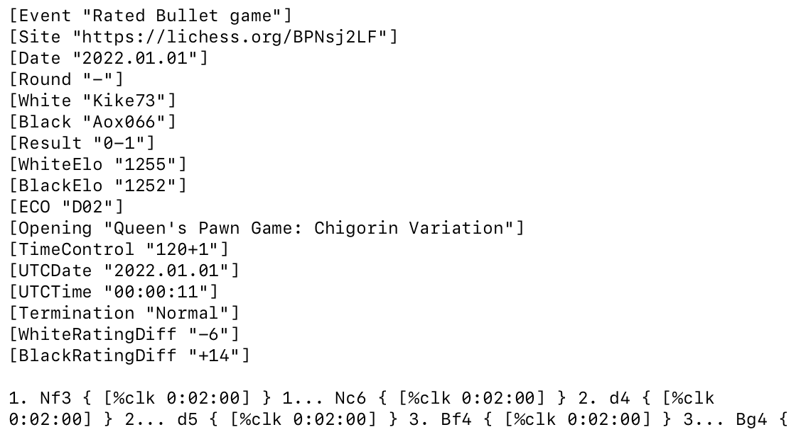
Design, Methods, and Implementation: Downloading the Data
Lichess Open Database
Rated Blitz (179 - 479 seconds) and Rated Rapid (479 - 1499 seconds) games
Games in 2022
Each month is ~30GB before sampling
Sampled 6 million games per month
PGN (Portable Game Notation) files
Headers (e.g. White and Black players, their ratings, opening, game result)
List of moves in the game

Slide 7
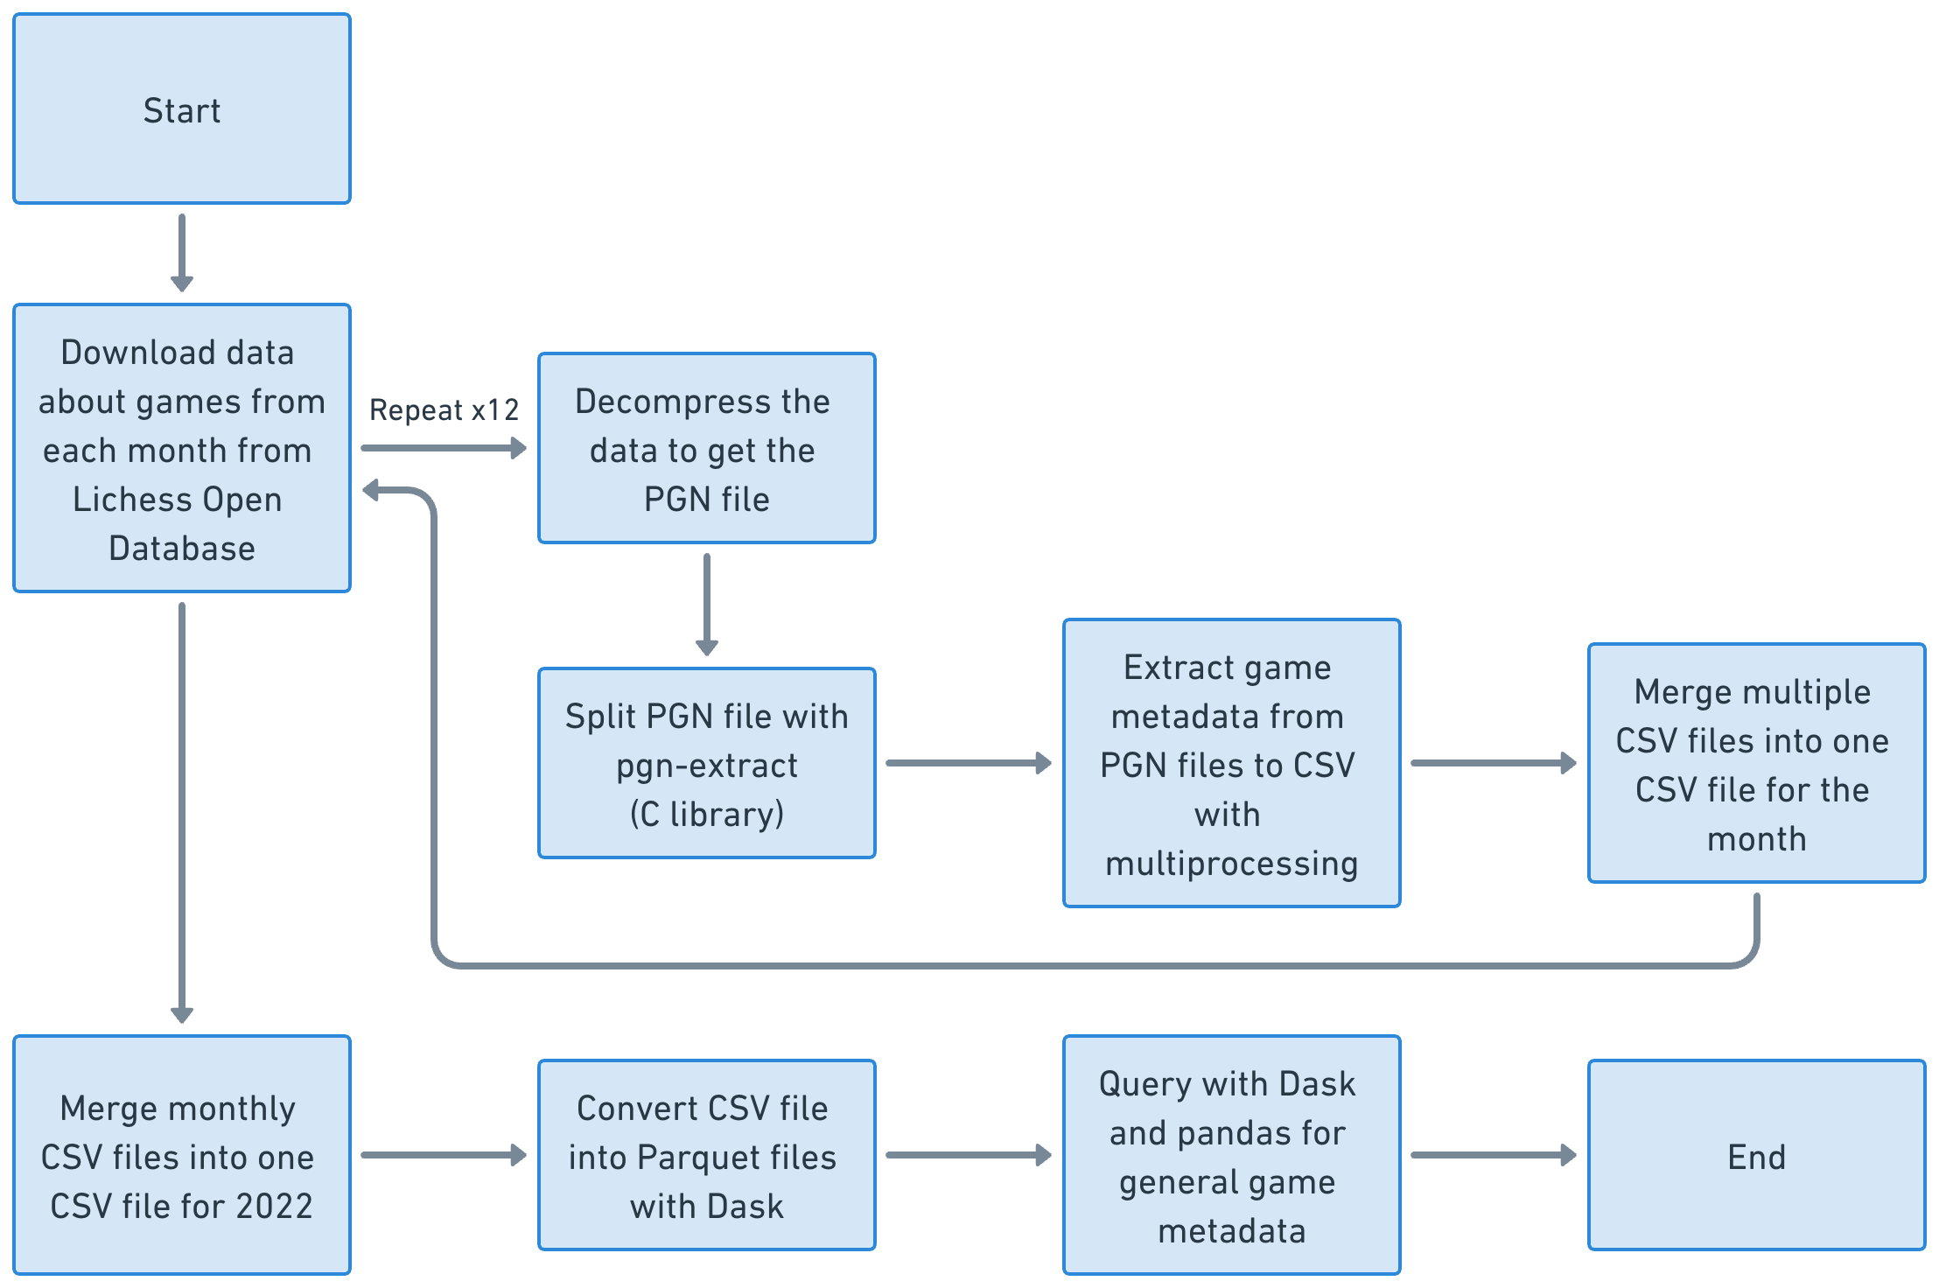
Design, Methods, and Implementation: Data Processing
PGN → CSV → Parquet files
Data analysis with Dask and pandas
Subsampled data for machine learning with random sampling
12.5% of original sample – approximately 5 million games

Slide 8
Conclusion: Project Outcomes
Decision tree and random forest classifiers to predict the result of chess games
Linear regression of popularity of base openings vs. their game results
K-means clustering of base openings by game results
K-means clustering of base openings by mean Euclidean distance of game results in their variations

Slide 9
Conclusion: Limitations
Long time to collect and process data
Only used the metadata of games
Only used games from Lichess

Slide 10


Conclusion: Future Work
Include game data from various sources
e.g. FICS Games Database
Use data for a longer period
e.g. popularity of openings vs. search popularity on Google Trends
Use Scoutfish for low-level analysis
e.g. explore endgame move sequences
Integrate Stockfish into data pipeline
e.g. explore blunder rate

